Slide 1
Beyond Excel: Why You Should Learn How to Code
(At least a little bit)
Dataharvest 2020 | Robert Gebeloff |@gebeloffnyt

Slide 2
Please learn to program….
I’ve been a data journalist for more than 20 years, and have worked for The New York Times since 2008.
This is my fifth Dataharvest conference, and I hope to see all of you in Mechelen next year.
The goal of this talk is not to teach you how to program, but to hopefully inspire you to want to learn. I am NOT a programmer myself, but I have learned to code a bit because it makes my life as a reporter easier and opens up new lines of inquiry for my reporting.

Slide 3

Why Data Journalism?
Reporting is what you see
Reporting is what people tell you
Reporting is what you find in documents
Data gives you the power to ask questions you wouldn’t be able to get at otherwise

Slide 4
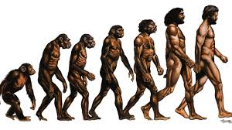
My Evolution In Data Journalism

Slide 5
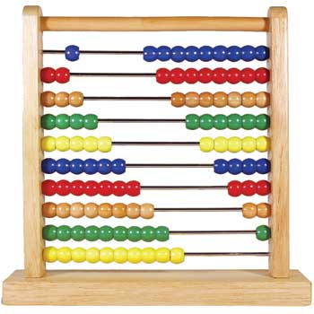
My Evolution in Data Journalism
Math
add, subtract, multiple divide.
percent change, percentage point difference
context - true but is it meaningful? What’s the best measure

Slide 6
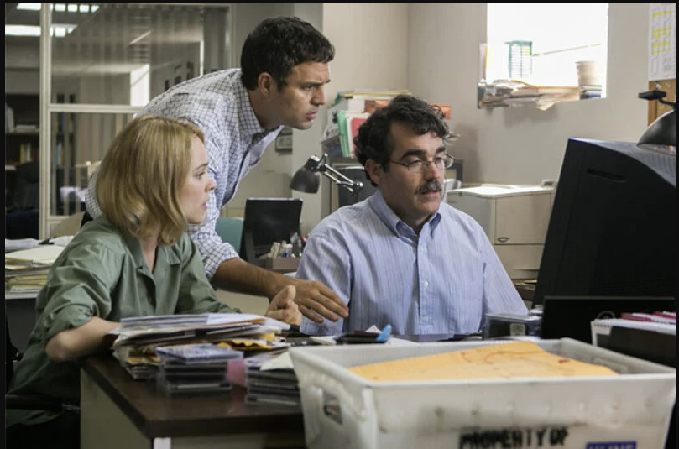
My Evolution in Data Journalism
Spreadsheets
Thinking in rows and columns
Mass calculations in an instant
Sorting the bestest and worstest
Grouping and summing crosstabs

Slide 7
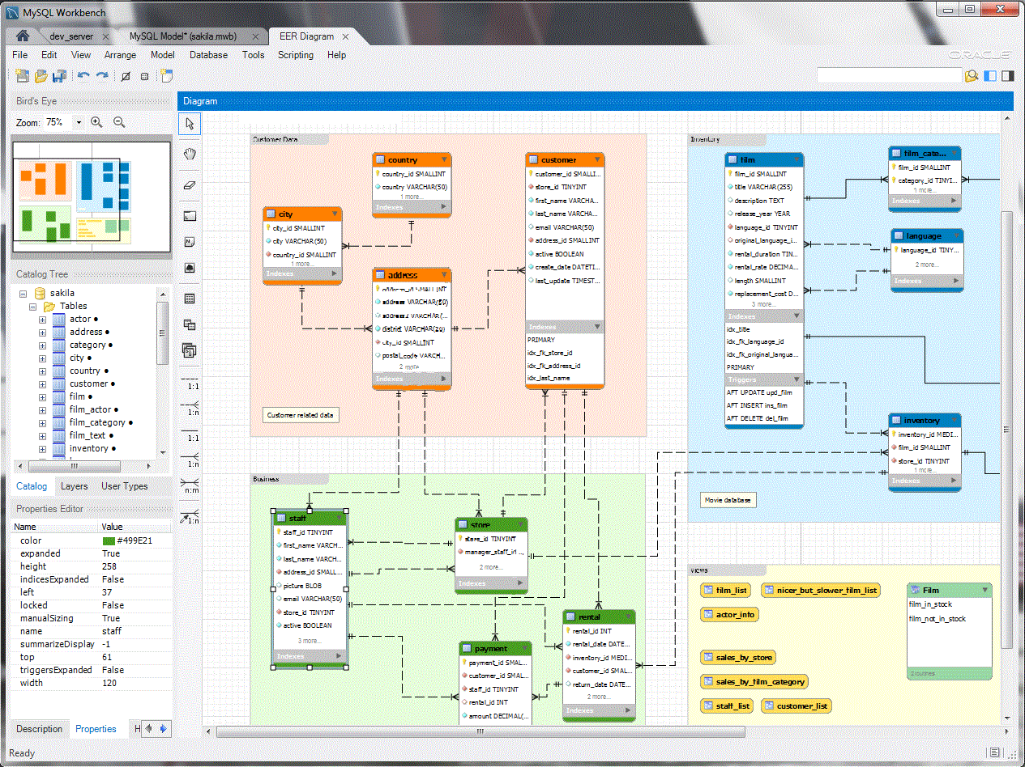
My Evolution in Data Journalism
Database managers
Large datasets
More sophisticated grouping and summing
The almighty WHERE clause
Joining different data together
Repeatable code

Slide 8
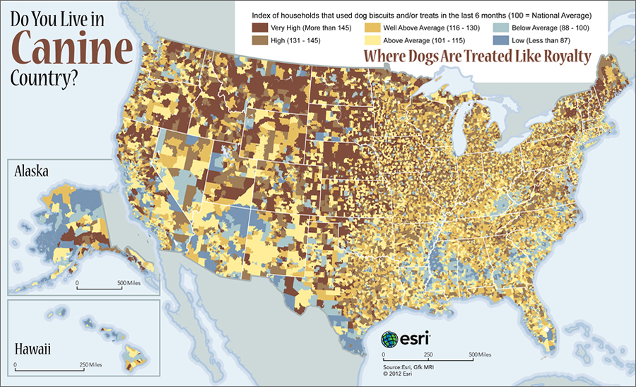
The Evolution of Data Journalism
GIS software
Geographic patterns not obvious from staring at tables
Converting addresses to locations
Spatial joins

Slide 9
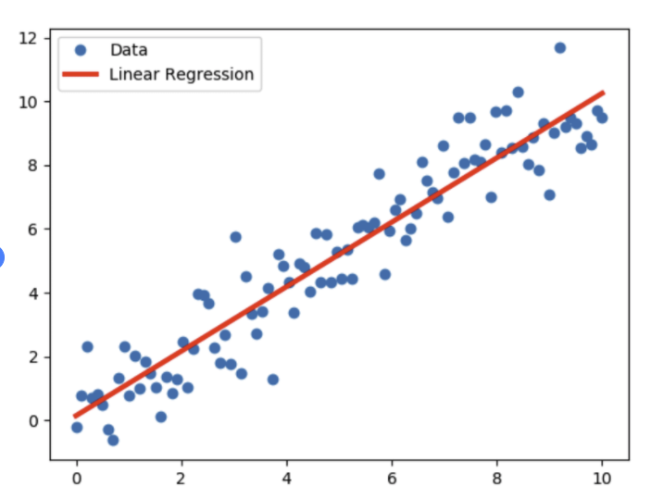
My Evolution in Data Journalism
Statistical software
Formal statistical reports
Margin of error, Chi Square etc
Linear Regression
Logistic Regression

Slide 10
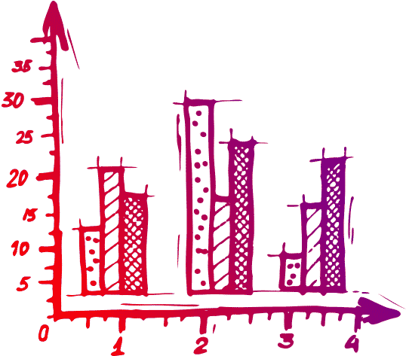
My Evolution In Data Journalism
Data Viz
Graphical representation of data
Show relationship of variables
Show trends over time
“Visual Stories”

Slide 11

Yeah I Was Good, But...
I was dependent on FOI
My workflow was a mess
My workflow was not repeatable
My reporting “range” was limited because I didn’t know what was possible
Gebeloff mansplaining, earlier in his career

Slide 12
Programming
Let’s be clear: Large news orgs like my own hire lots of news nerds from a programming background.
I’m not one of them. I’m not saying you should become one of them.
I mean, they’re fabulous and all and have a crucial role in news.
What I am proposing is this: We should all learn a little programming because

Slide 13
Programming
You can vastly expand the range of possible reporting inquiries
You can do difficult data tasks faster
You can do complicated data tasks in a more orderly, repeatable fashion
It’s easier to learn than ever.
You can learn by starting small and build up your skills over time.

Slide 14
Programming
Interacting with Web sites like a programmer:
http://search.electoralcommission.org.uk/?currentPage=1&rows=10&sort=AcceptedDate&order=desc&tab=1&open=filter&et=pp&et=ppm&et=tp&et=perpar&et=rd&isIrishSourceYes=true&isIrishSourceNo=true&date=Reported&from=&to=&quarters=2020q1234&quarters=2019q1234&prePoll=false&postPoll=true&donorStatus=individual&donorStatus=tradeunion&donorStatus=company&donorStatus=unincorporatedassociation&donorStatus=publicfund&donorStatus=other&donorStatus=registeredpoliticalparty&donorStatus=friendlysociety&donorStatus=trust&donorStatus=limitedliabilitypartnership&donorStatus=impermissibledonor&donorStatus=na&donorStatus=unidentifiabledonor&donorStatus=buildingsociety&register=gb&register=ni&register=none&optCols=Register&optCols=CampaigningName&optCols=AccountingUnitsAsCentralParty&optCols=IsSponsorship&optCols=IsIrishSource&optCols=RegulatedDoneeType&optCols=CompanyRegistrationNumber&optCols=Postcode&optCols=NatureOfDonation&optCols=PurposeOfVisit&optCols=DonationAction&optCols=ReportedDate&optCols=IsReportedPrePoll&optCols=ReportingPeriodName&optCols=IsBequest&optCols=IsAggregation
http://search.electoralcommission.org.uk/api/csv/Donations?start={start}&rows={pageSize}&query=&sort=AcceptedDate&order=desc&et=pp&et=ppm&et=tp&et=perpar&et=rd&date=Reported&from=&to=&rptPd=&prePoll=false&postPoll=true&quarters=2020q1234&quarters=2019q1234&register=gb&register=ni&register=none&donorStatus=individual&donorStatus=tradeunion&donorStatus=company&donorStatus=unincorporatedassociation&donorStatus=publicfund&donorStatus=other&donorStatus=registeredpoliticalparty&donorStatus=friendlysociety&donorStatus=trust&donorStatus=limitedliabilitypartnership&donorStatus=impermissibledonor&donorStatus=na&donorStatus=unidentifiabledonor&donorStatus=buildingsociety&isIrishSourceYes=true&isIrishSourceNo=true&includeOutsideSection75=true
http://landregistry.data.gov.uk/app/ppd/search?et%5B%5D=lrcommon%3Afreehold&et%5B%5D=lrcommon%3Aleasehold&limit=100&nb%5B%5D=true&nb%5B%5D=false&ptype%5B%5D=lrcommon%3Adetached&ptype%5B%5D=lrcommon%3Asemi-detached&ptype%5B%5D=lrcommon%3Aterraced&ptype%5B%5D=lrcommon%3Aflat-maisonette&ptype%5B%5D=lrcommon%3AotherPropertyType&street=abbey+road&tc%5B%5D=ppd%3AstandardPricePaidTransaction&tc%5B%5D=ppd%3AadditionalPricePaidTransaction&town=London

Slide 15
Programming
Dealing with data in non-standard formats (json, xml)
Obtaining data via APIs
Obtaining data via packages built on top of APIs
Scraping data that you cannot obtain otherwise
Pulling text out of documents, parsing and analyzing
Automating repetitive tasks
Miscellaneous tasks that further your reporting

Slide 16
Programming
In sum, programming makes traditional data journalism easier and replicable and often opens up lines of inquiry not possible without programming.

Slide 17
Programming… in Action!
(in which we switch over to an R script)

Slide 18
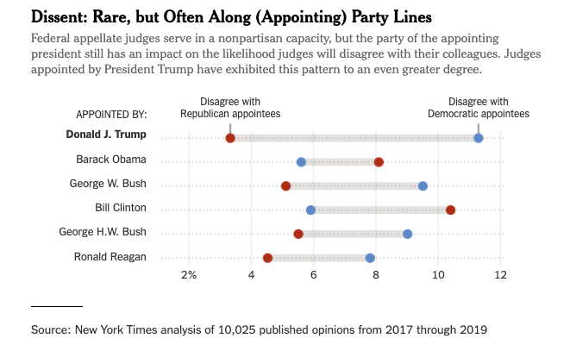
Story Examples...
Are Trump judicial appointees especially conservative?
Scraped case texts
Parsed text to pull out judge names and names of judges writing opinion
Built internal db with Web interface for proofing, note-taking, sharing findings with colleagues

Slide 19
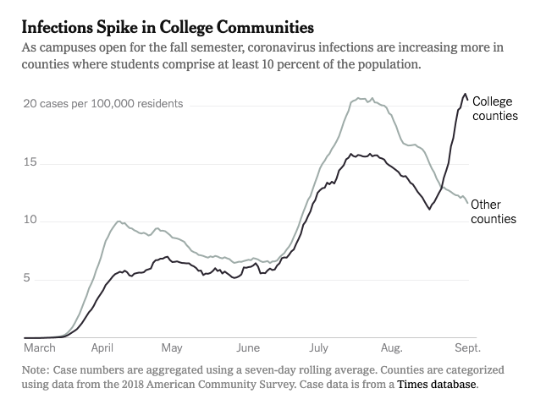
Story Examples...
College Towns as Coronavirus Hot Spots
Use internal API to obtain county level virus data
Use U.S. Census API/R Package to obtain population and college student population data

Slide 20
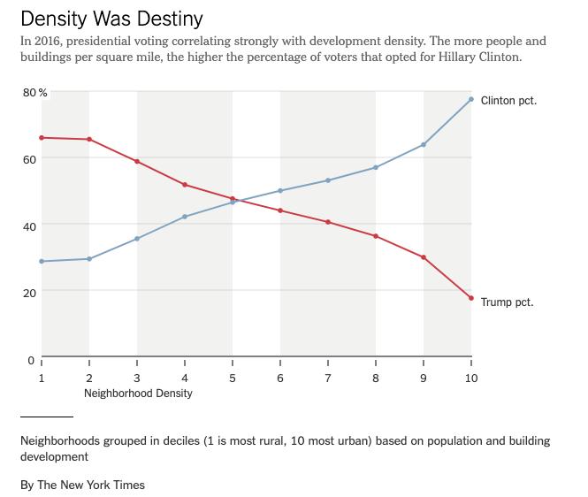
Story Examples...
What are the Suburbs Anyway?
Special problem solving -- joining a satellite image showing building density with map of U.S. divided into 70,000+ neighborhoods

Slide 21
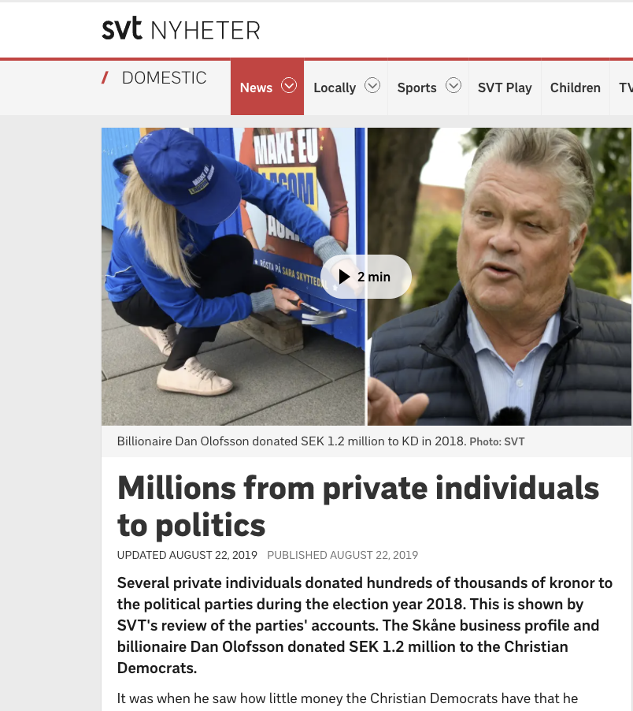
Story Examples...
Scraping Swedish Political Donations
The Swedish election of 2018 was the first election where the private donations became public. Regulators posted a simple lookup tool but SVT scraped the database and pulled other records out of PDF files

Slide 22

Story Examples...
Unsafe Roads in Sweden
To document unsafe roads in Sweden, reporters needed to learn a lot about road engineering but also needed to acquire road data from a government API

Slide 23

Story Examples...
When Oligarchs Snap up Real Estate
Ownership information for this project was locked in about 200 PDF files that had to be parsed programmatically to liberate the data

Slide 24
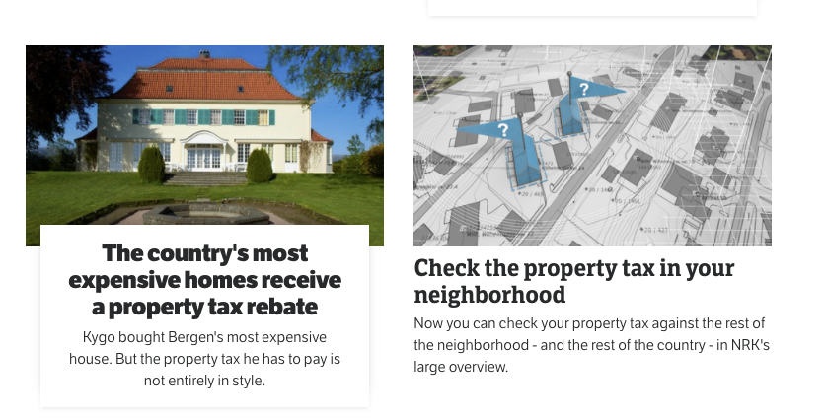
Story Examples...
How to Property Taxes Work in Norway?
The national broadcaster NRK used a combo of scraping and FOIA requests to give their audience an unprecedented understanding of the property tax system.

Slide 25
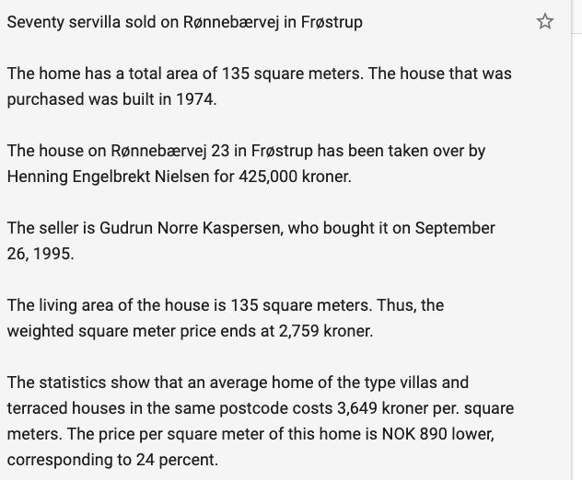
Story Examples...
Denmark Homesale Robot
Our best example is how we make a total scraping of the system called Tinglysning, which is the register of houses and flats, buying and selling of that in Denmark. It is meant to be open by law, but it is very difficult to structure and find your way around in. It means we have all the houses/flats/other buildings, all the owners, all the contract-information and many of the debts, we do this by scraping an API, which is not documented and parsing data from several sources into the database on the server.

Slide 26
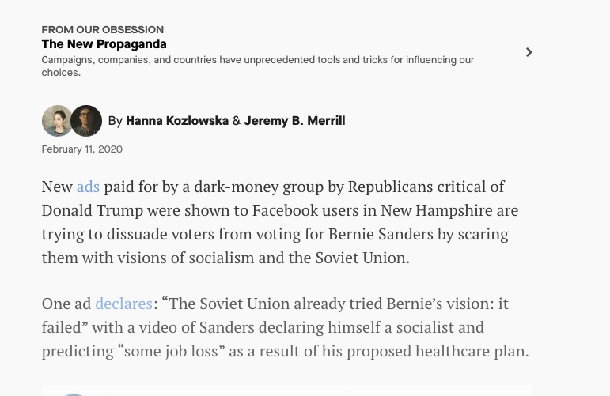
Story Examples...
Dark Money in U.S. Politics
Quartz automatically scrapes Facebook ad spending on a daily basis, creating a long-term database they can mine for trend stories.

Slide 27
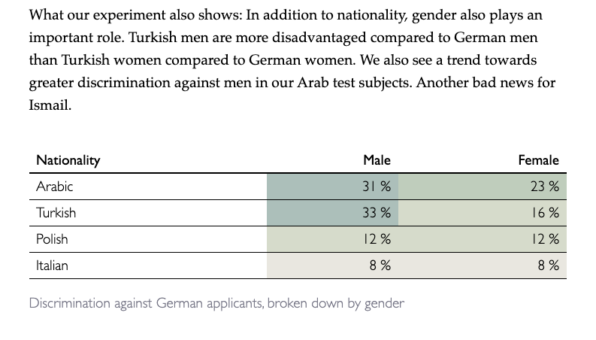
Story Examples...
Rental Discrimination in Germany
Bayerischer Rundfunk and Der Spiegel created a program that sent in thousands of applications for apartments for people of different genders and nationalities, and tracked who was invited in for a visit.

Slide 28
Learn to Program...
Come to these conferences
R: https://r4ds.had.co.nz/
Python: https://www.firstpythonnotebook.org/
It helps to have a project in mind when you learn vs learning for learnings sake
Thanks to: Helena Bengtsson, John Bones, Jeremy Merrill, Nils Mulvad and Jonathan Stoneman for providing great examples.

